Slide 1
Digital Fundamentals
CHAPTER 5
Combinational Logic Analysis

Slide 2
5–3 The Universal Property of NAND and NOR Gates
The universality of the NAND gate means that it can be used as an inverter and that combinations of NAND gates can be used to implement the AND, OR, and NOR operations. Similarly, the NOR gate can be used to implement the inverter (NOT), AND, OR, and NAND operations.

Slide 3

The Universal Property of NAND Gates
NAND Gate as an Inverter
An inverter can be made from a NAND gate by connecting
all of the inputs together and creating, in effect, a single input

Slide 4

The Universal Property of NAND Gates
Two NAND Gates as an AND Gate

Slide 5
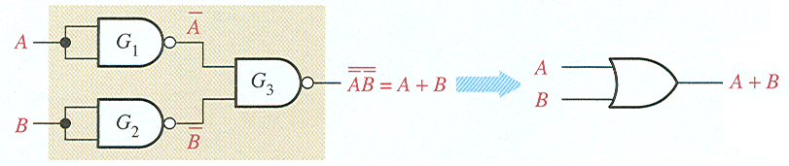
The Universal Property of NAND Gates
Three NAND Gates as an OR Gate

Slide 6
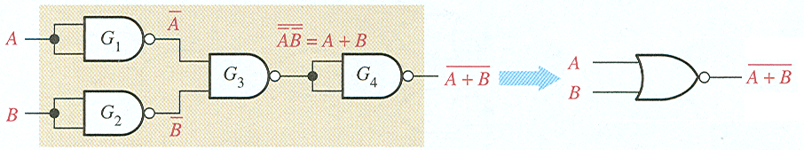
The Universal Property of NAND Gates
Four NAND Gates as OR Gate

Slide 7

The Universal Property of NOR Gates
NOR Gate as an Inverter

Slide 8

The Universal Property of NOR Gates
Two NOR Gates as an OR Gate

Slide 9
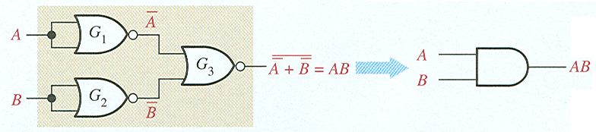
The Universal Property of NOR Gates
Three NOR Gates as an AND Gate

Slide 10
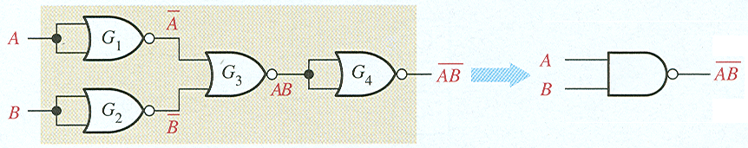
The Universal Property of NOR Gates
Four NOR Gates as an AND Gate

Slide 11
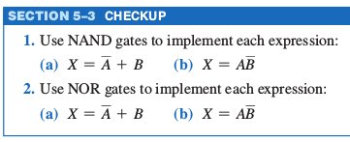

Slide 12
5–4 Combinational Logic Using NAND and NOR Gates

Slide 13
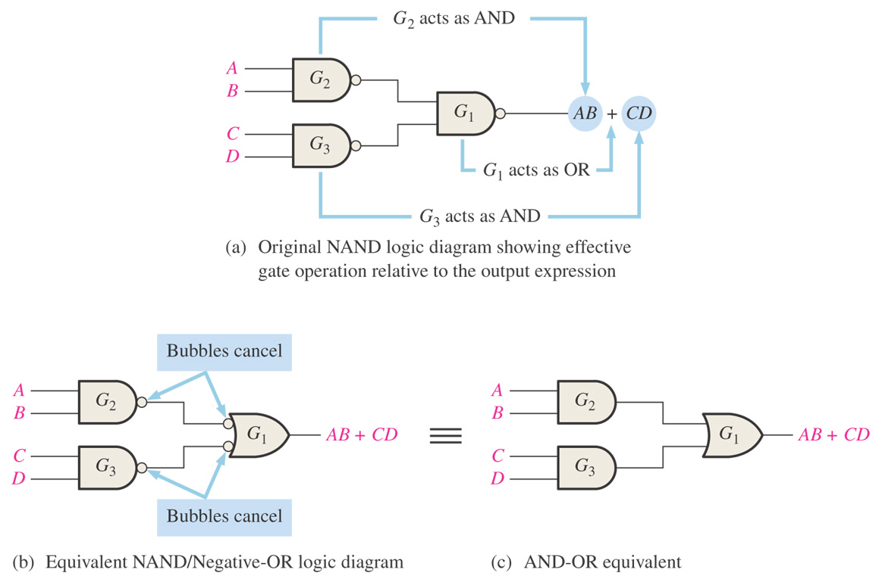
Figure 5–19 Development of the AND-OR equivalent of the circuit in Figure 5–18.
Thomas L. Floyd
Digital Fundamentals, 9e
Copyright ©2006 by Pearson Education, Inc.
Upper Saddle River, New Jersey 07458
All rights reserved.

Slide 14
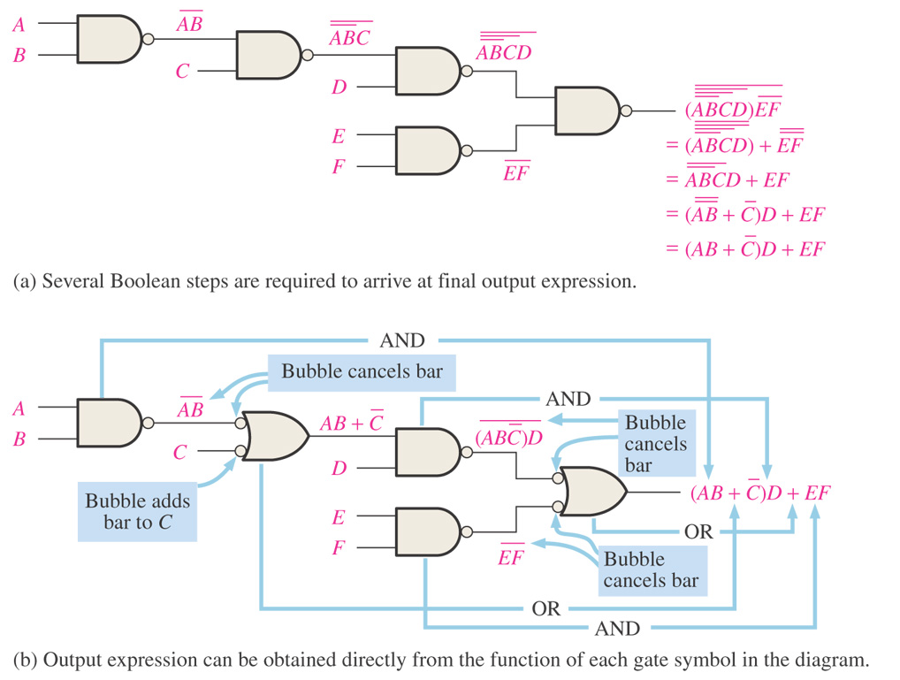
Figure 5–20 Illustration of the use of the appropriate dual symbols in a NAND logic diagram.
The NAND symbol and the negative-OR symbol are called dual symbols.
Thomas L. Floyd
Digital Fundamentals, 9e
Copyright ©2006 by Pearson Education, Inc.
Upper Saddle River, New Jersey 07458
All rights reserved.

Slide 15
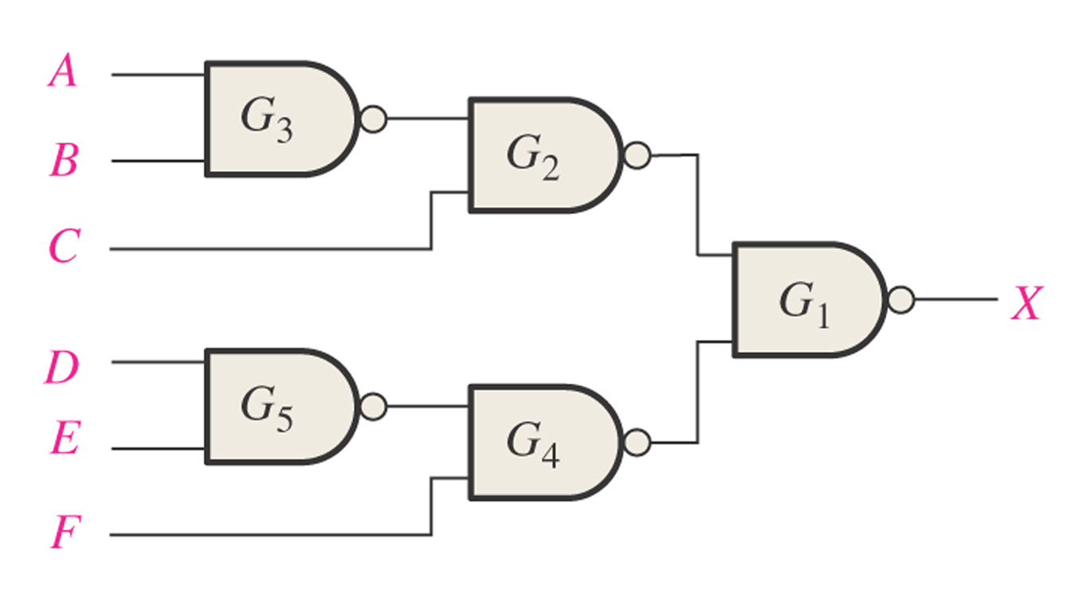
Figure 5–21
Example 5-9. Redraw using appropriate dual symbols.
Thomas L. Floyd
Digital Fundamentals, 9e
Copyright ©2006 by Pearson Education, Inc.
Upper Saddle River, New Jersey 07458
All rights reserved.

Slide 16
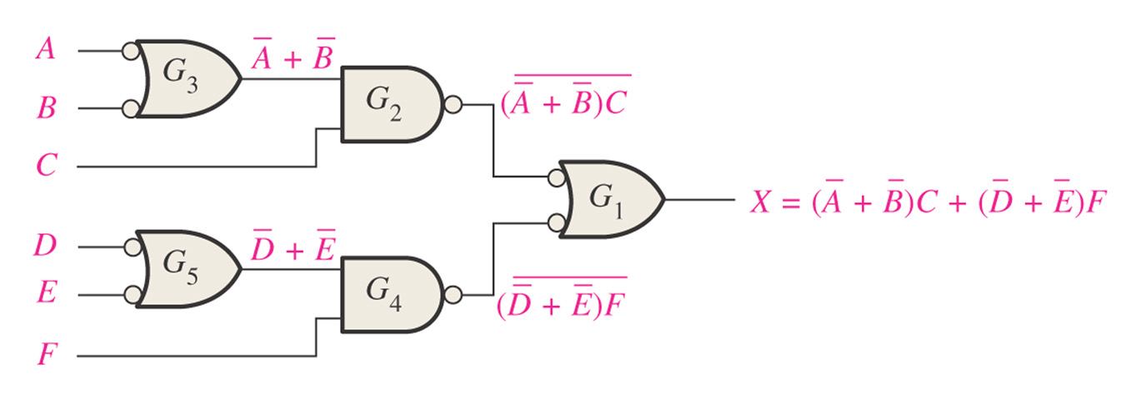
Figure 5–22
Thomas L. Floyd
Digital Fundamentals, 9e
Copyright ©2006 by Pearson Education, Inc.
Upper Saddle River, New Jersey 07458
All rights reserved.

Slide 17

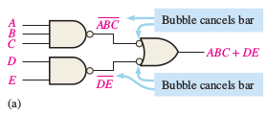
Figure 5–21
Implement each expression with NAND logic using appropriate dual symbols:
Thomas L. Floyd
Digital Fundamentals, 9e
Copyright ©2006 by Pearson Education, Inc.
Upper Saddle River, New Jersey 07458
All rights reserved.

Slide 18

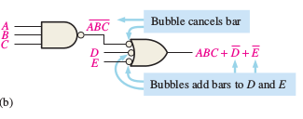
Figure 5–21
Implement each expression with NAND logic using appropriate dual symbols:
Thomas L. Floyd
Digital Fundamentals, 9e
Copyright ©2006 by Pearson Education, Inc.
Upper Saddle River, New Jersey 07458
All rights reserved.

Slide 19
NOR Logic – Negative AND
A NOR gate can function as either a NOR or a negative-AND, as shown by DeMorgan’s theorem.
A + B = A B
NOR negative AND

Slide 20
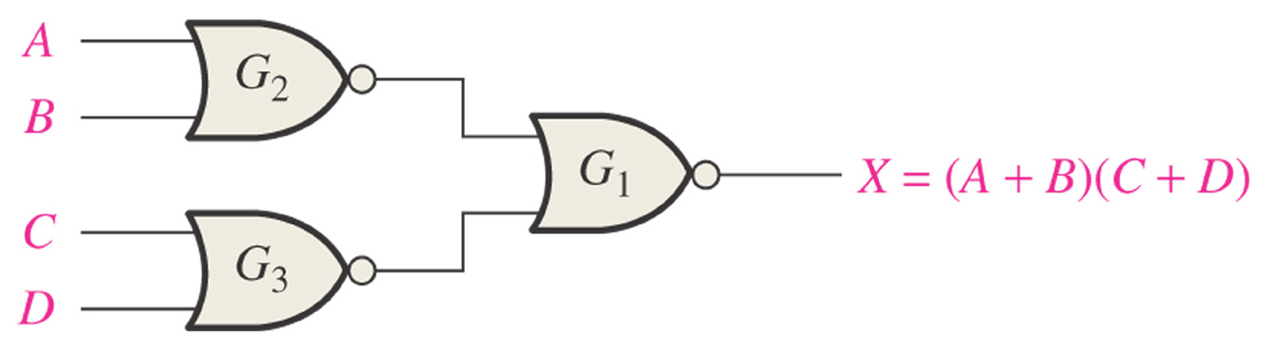
Figure 5–24 NOR logic for X = (A + B)(C + D).
NOR Logic – Negative AND
1
A + B
A + B
+
C+D
=
(A+B)
(C+D)
3
2
C+D
Thomas L. Floyd
Digital Fundamentals, 9e
Copyright ©2006 by Pearson Education, Inc.
Upper Saddle River, New Jersey 07458
All rights reserved.

Slide 21
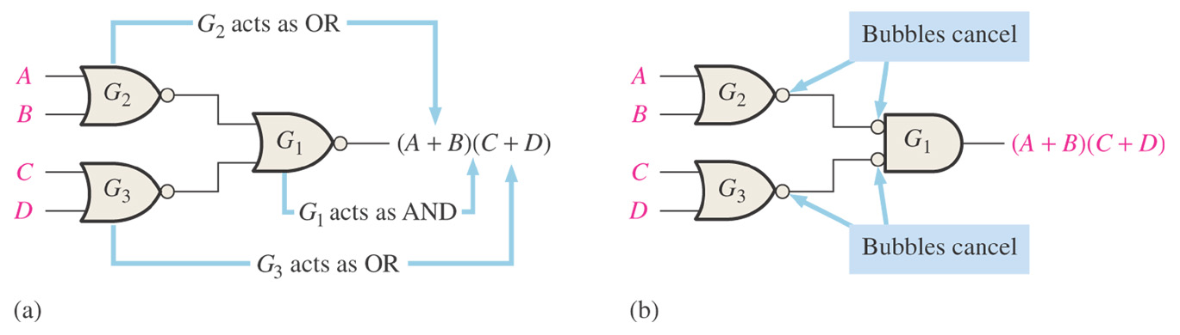
Figure 5–25
NOR Logic Diagram Using Dual Symbols
Thomas L. Floyd
Digital Fundamentals, 9e
Copyright ©2006 by Pearson Education, Inc.
Upper Saddle River, New Jersey 07458
All rights reserved.

Slide 22
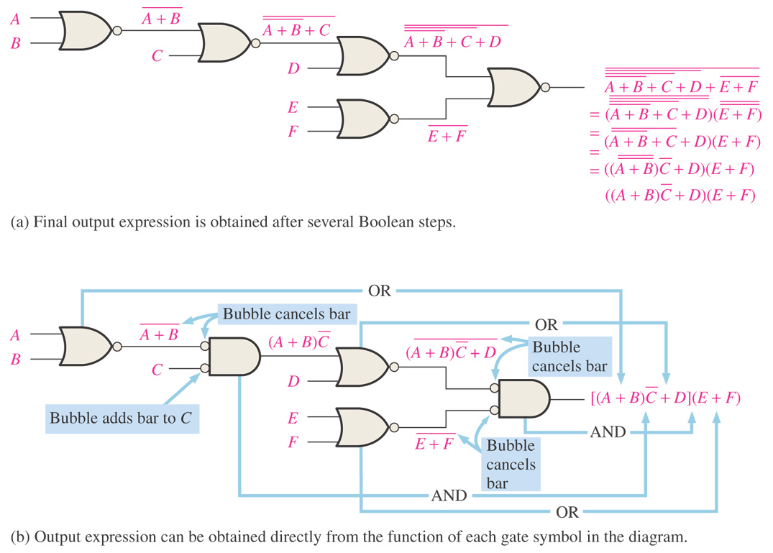
Figure 5–26 Illustration of the use of the appropriate dual symbols in a NOR logic diagram.
1
2
3
5
4
Thomas L. Floyd
Digital Fundamentals, 9e
Copyright ©2006 by Pearson Education, Inc.
Upper Saddle River, New Jersey 07458
All rights reserved.

Slide 23
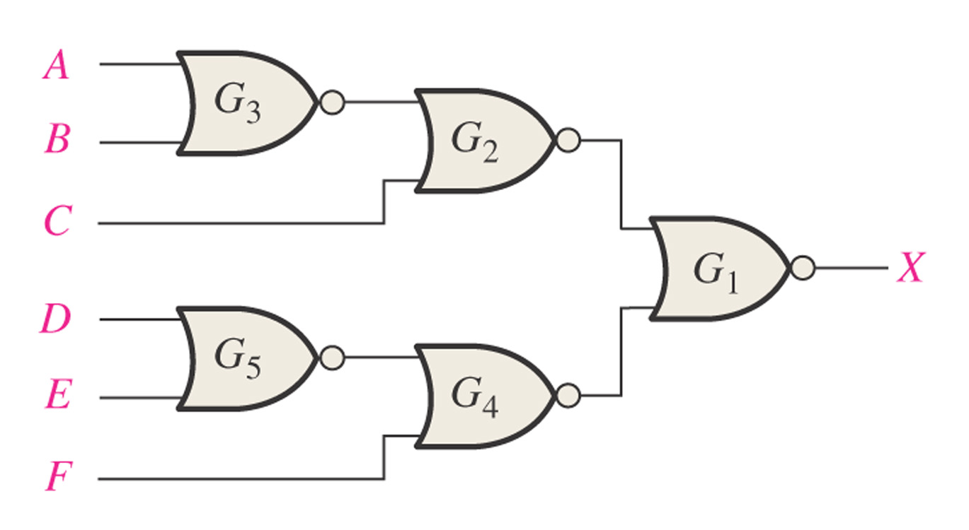
Figure 5–27
EXAMPLE: Redraw using appropriate Dual symbols.
Thomas L. Floyd
Digital Fundamentals, 9e
Copyright ©2006 by Pearson Education, Inc.
Upper Saddle River, New Jersey 07458
All rights reserved.

Slide 24
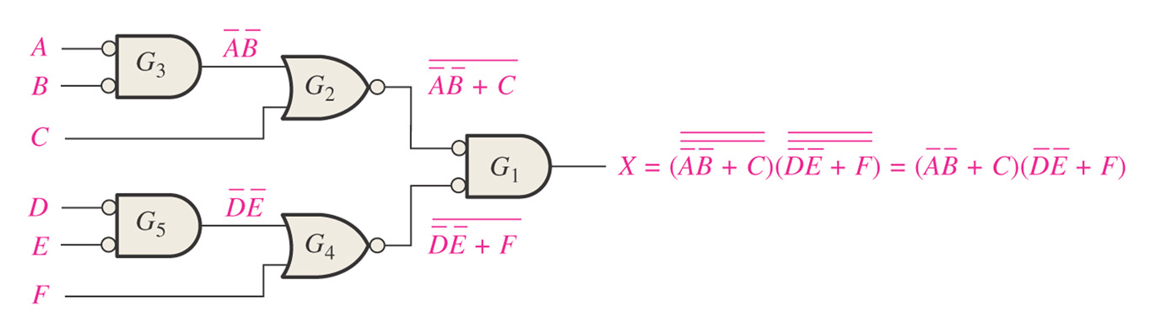
Figure 5–28
Thomas L. Floyd
Digital Fundamentals, 9e
Copyright ©2006 by Pearson Education, Inc.
Upper Saddle River, New Jersey 07458
All rights reserved.

Slide 25


Slide 26
5–5 Pulse Waveform Operation
General combinational logic circuits with pulse waveform inputs are examined in this section. Keep in mind that the operation of each gate is the same for pulse waveform inputs as for constant-level inputs. The output of a logic circuit at any given time depends on the inputs at that particular time, so the relationship of the time-varying inputs is of primary importance.
Analyze combinational logic circuits with pulse waveform inputs
Develop a timing diagram for any given combinational logic circuit with specified inputs

Slide 27
5–5 Pulse Waveform Operation
review of the operation of individual gates for use in analyzing combinational circuits with pulse waveform inputs:
1. The output of an AND gate is HIGH only when all inputs are HIGH at the same time.
2. The output of an OR gate is HIGH only when at least one of its inputs is HIGH.
3. The output of a NAND gate is LOW only when all inputs are HIGH at the same time.
4. The output of a NOR gate is LOW only when at least one of its inputs is HIGH.

Slide 28
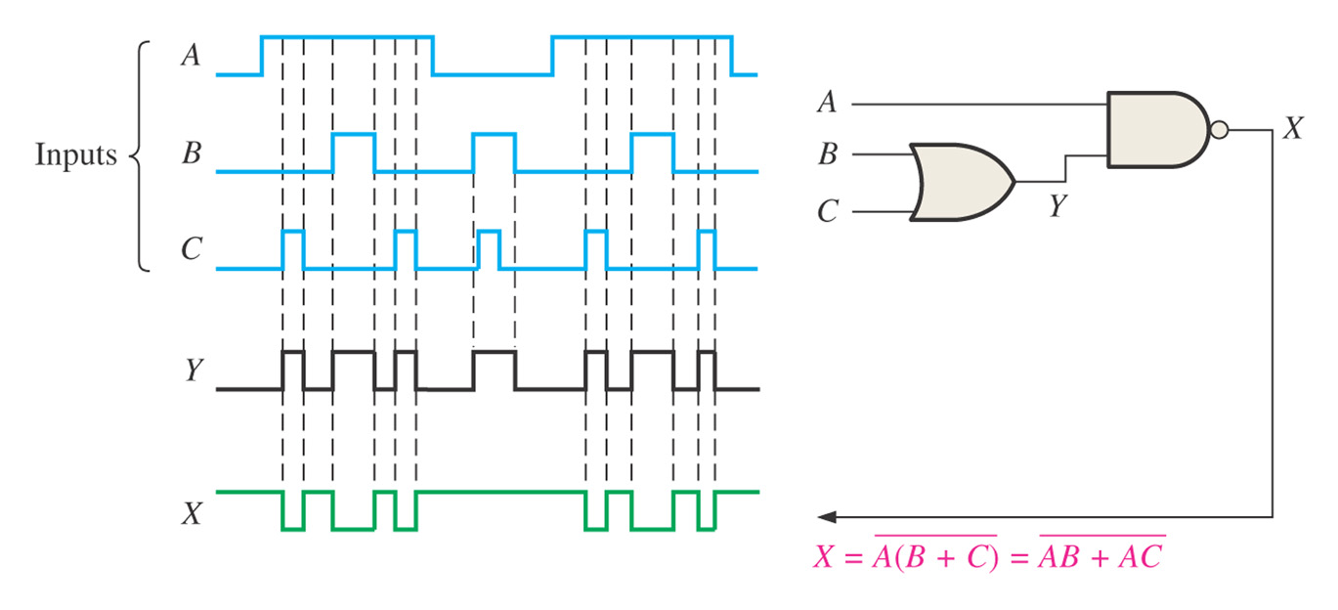
Figure 5–29
5–5 Pulse Waveform Operation
Thomas L. Floyd
Digital Fundamentals, 9e
Copyright ©2006 by Pearson Education, Inc.
Upper Saddle River, New Jersey 07458
All rights reserved.

Slide 29
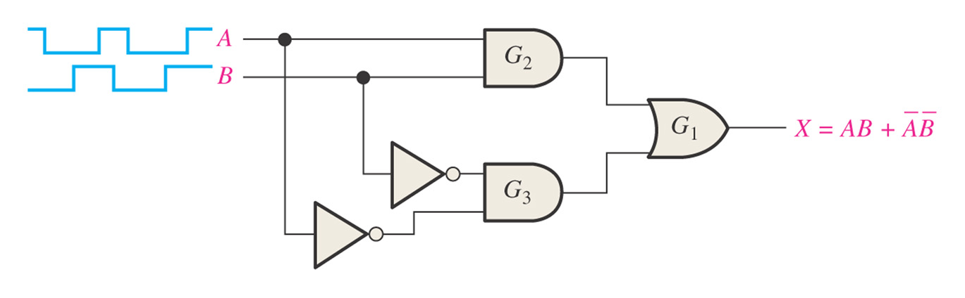
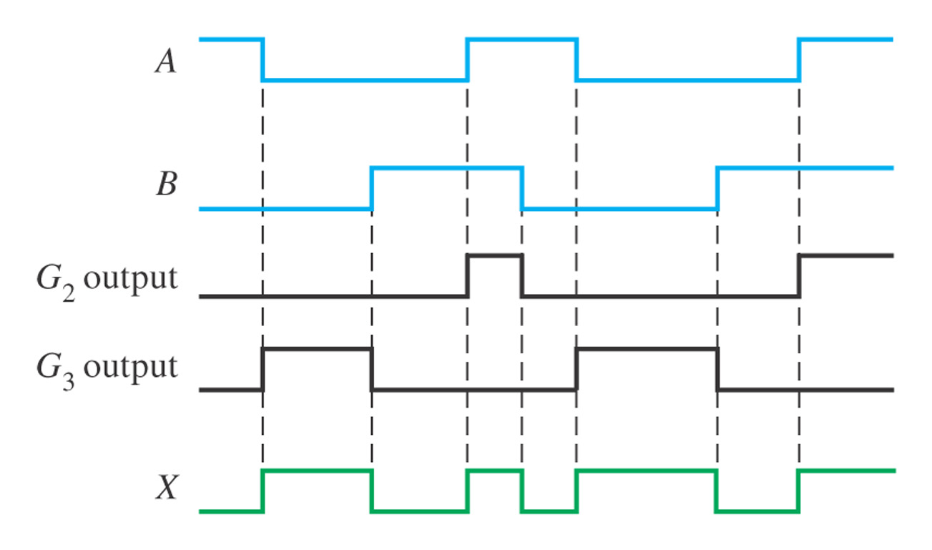
Figure 5–30
Draw the timing diagram with the given inputs showing the outputs of G1 , G2 ,and G3 with the input waveforms, A, and B, as indicated
Thomas L. Floyd
Digital Fundamentals, 9e
Copyright ©2006 by Pearson Education, Inc.
Upper Saddle River, New Jersey 07458
All rights reserved.

Slide 30
